Slide 1


micro:bit entry video tutorial
Lesson 14
micro:bit sensor lesson 14 “Red is stop, green is go”
YahBoom micro:bit module tutorial

Slide 2
micro:bit entry video tutorial
Content
Part1
Part 2
Part3
Part 4
Part 5
Learning goals
Preparation
Connection
Search for blocks
Combine blocks
YahBoom micro:bit module tutorial

Slide 3
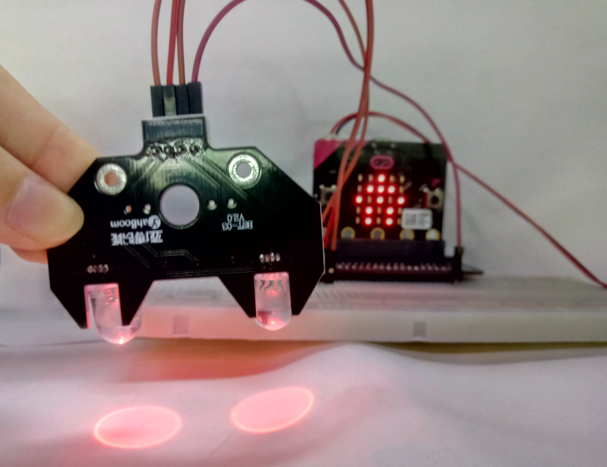
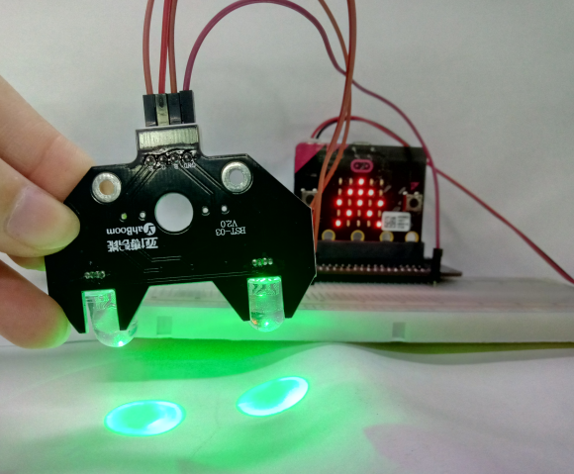
micro:bit entry video tutorial
Part 1
Learning goals
Do you know what the traffic rules on the road are, boys and girls? Red is stop, green is go. When children cross the street, they must have adults around. And the red light is to let the car pass through, the green light to cross the road.
YahBoom micro:bit module tutorial

Slide 4
micro:bit entry video tutorial
Part 2
Hardware:
● 1 X Micro: bit Board
● 1 X Micro USB Cable
● 1 X Micro:bit breakout
● 4 X Male to male cable
● 1 X 830 holes breadboard
● 1 X RGB LED
Preparation
Then the micro:bit is connected to the computer through USB, and the computer will pop up a U disk and click the URL in the U disk to enter the programming interface. Input this URL https://github.com/lzty634158/yahboom_mbit_en to get the package.
YahBoom micro:bit module tutorial

Slide 5
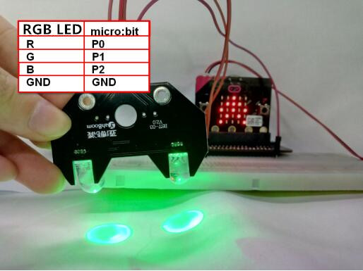
micro:bit entry video tutorial
Part 2
Connection
Connection line according to the upper drawing.
YahBoom micro:bit module tutorial

Slide 6
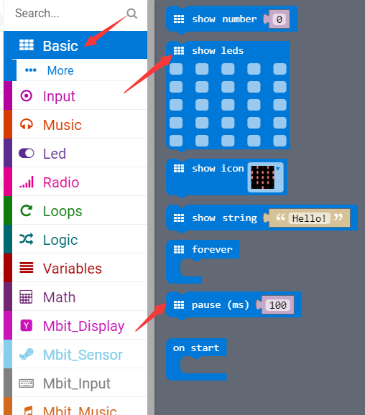
micro:bit entry video tutorial
Part 3
Search for blocks
YahBoom micro:bit module tutorial

Slide 7
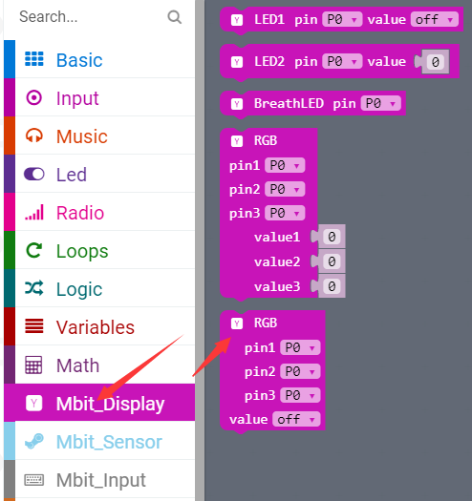
micro:bit entry video tutorial
Part 3
Search for blocks
YahBoom micro:bit module tutorial

Slide 8
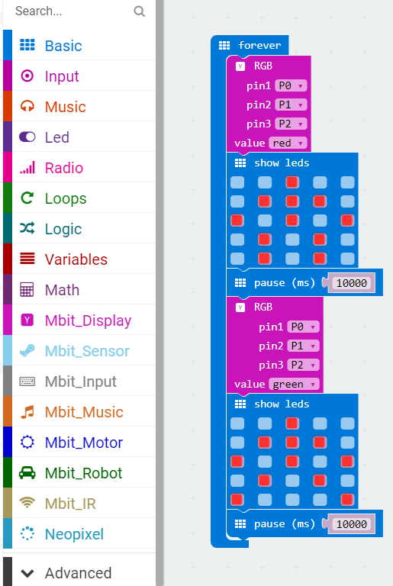
micro:bit entry video tutorial
Part 4
Combine blocks
YahBoom micro:bit module tutorial

Slide 9
micro:bit entry video tutorial
micro:bit
project
Thanks for watching！
Powered by YahBoom
YahBoom micro:bit module tutorial

